Slide 1
Finding Disk Galaxies at 3<z<6
Vicki Kuhn
7 February 2023

Slide 2
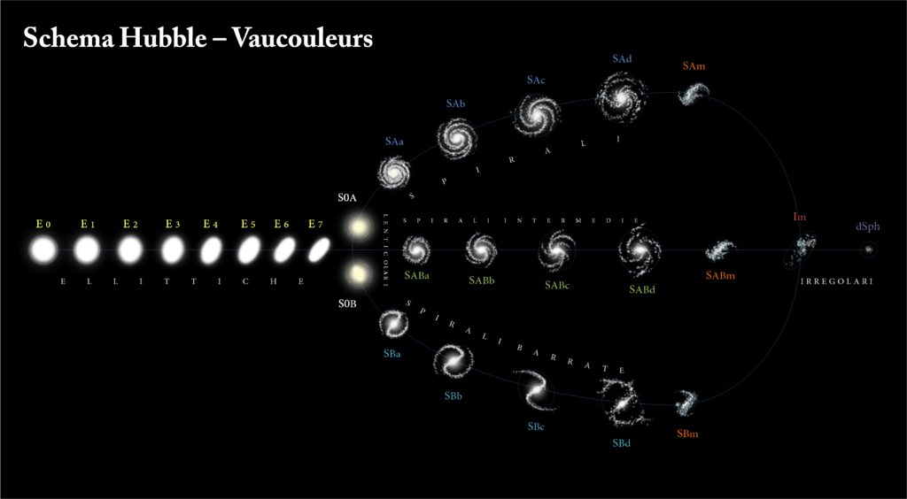
The Hubble Sequence
Image from https://www.physics.unlv.edu/~jeffery/astro/galaxies/savedir/galaxy_vaucouleur.html.

Slide 3
The Goal
Big picture: identify spiral barred galaxies
Details:
Stellar bars play an important role in the evolution of galaxies
Most spirals in today's universe are barred
NIR images are better to use than optical images due to lower dust extinction and star formation
We have only been able to see bars out to z~1 with optical images

Slide 4
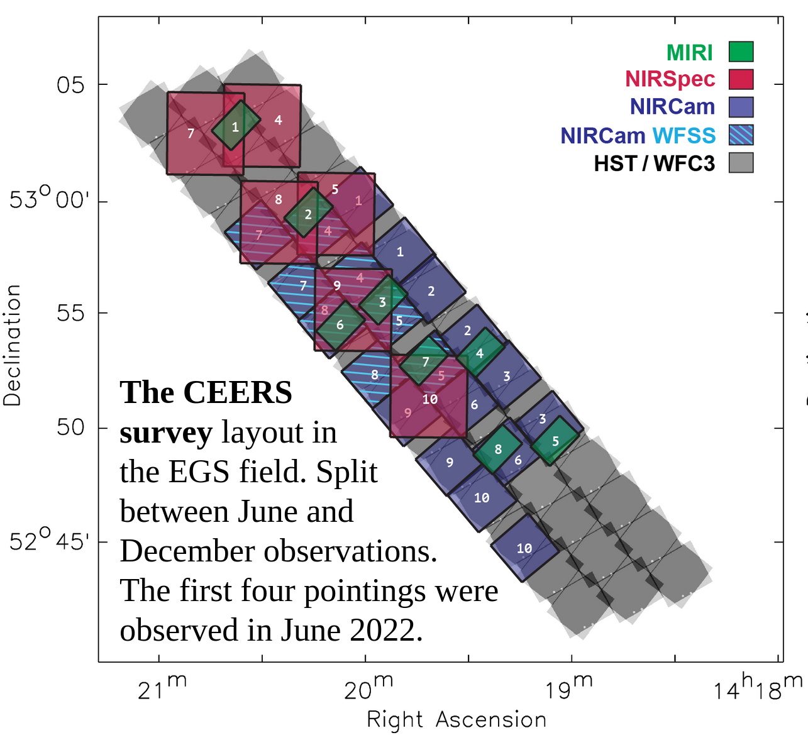

The Data
Cosmic Evolution Early Release Science Survey (CEERS)
There are currently 4 pointings (6 more to come)
Filters: F115W, F150W, F200W, F277W, F356W, F410M, F444W
Galaxies were chosen with $M_{∗}≥{10}^{9}M_{⊙}$ and $3<z<6$
604 galaxies are presented in the sample
Image from https://ceers.github.io/obs.html.

Slide 5
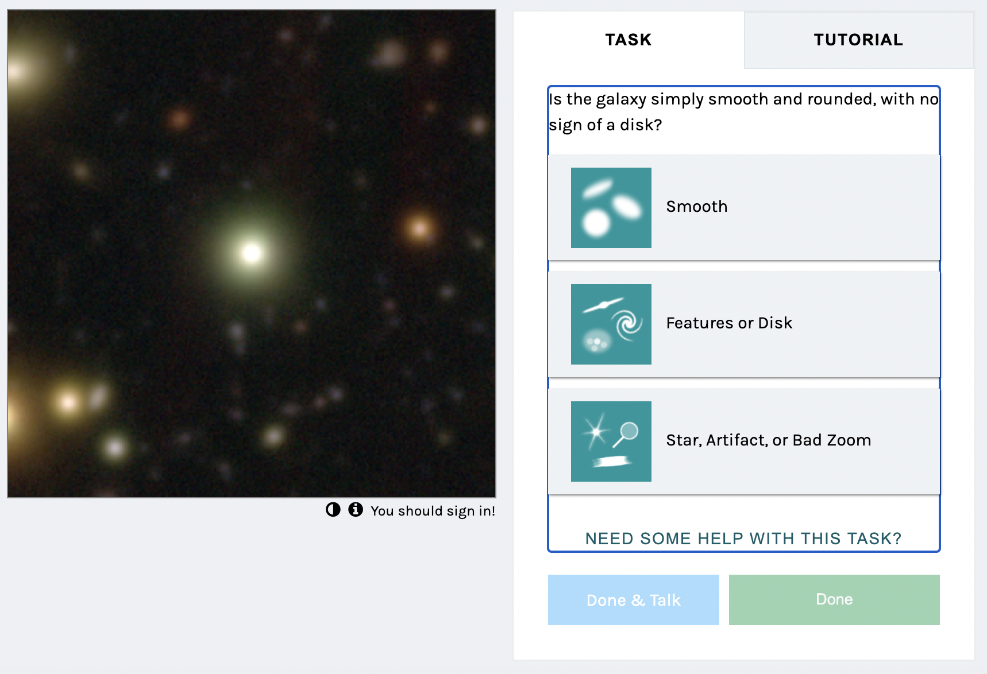
Your Goal
Main goal: classify galaxies
Currently set up in excel
Future work will be to make a website
Image taken from GalaxyZoo.

Slide 6
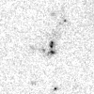
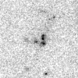
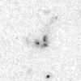
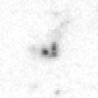
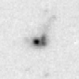
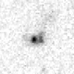
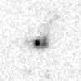
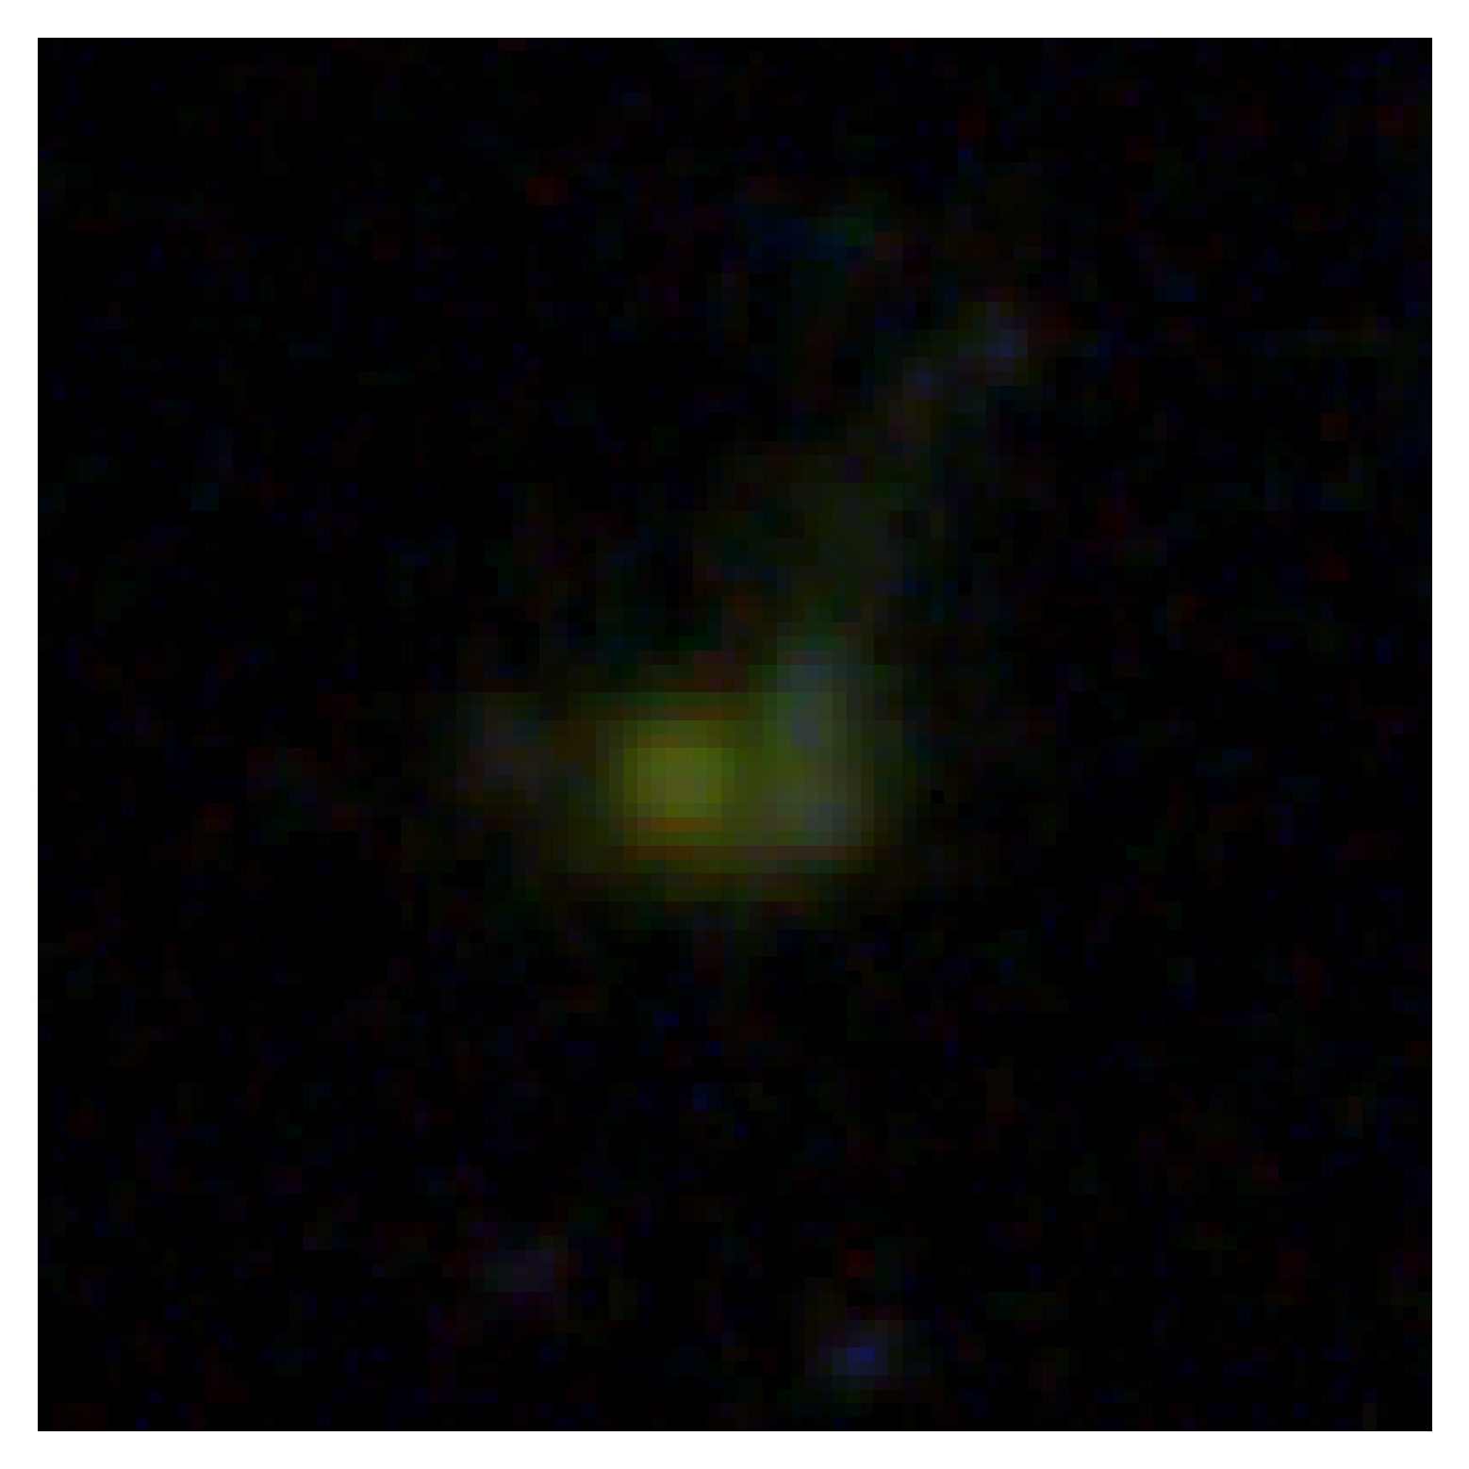
Your Goal
Main goal: classify galaxies
Currently set up in excel
Future work will be to make a website
F115W F150W F200W F277W F356W F410M F444W RGB

Slide 7
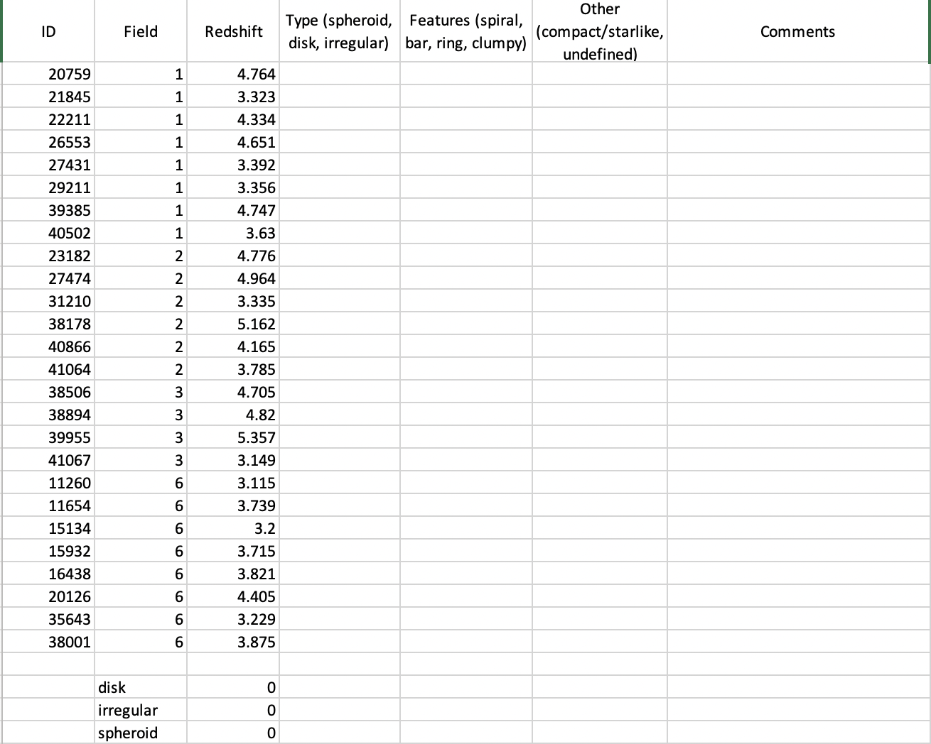
Your Goal
Main goal: classify galaxies
Currently set up in excel
Future work will be to make a website

Slide 8
Your Goal
First three columns are the EGS ID number, the pointing the object is in, and the redshift of the object.
Next column, type: spheroid, disk, and irregular
Spheroid: resolved, centrally concentrated with a smooth profile that is round/elliptical
Disk: resolved disk with increasing surface brightness towards the center and may include some features
Irregular: disturbance or peculiarity that dominates

Slide 9
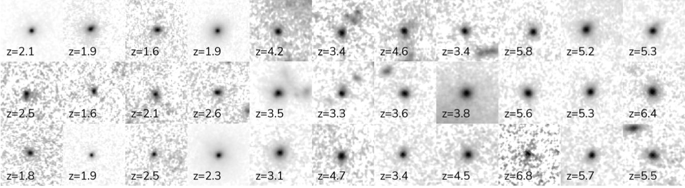
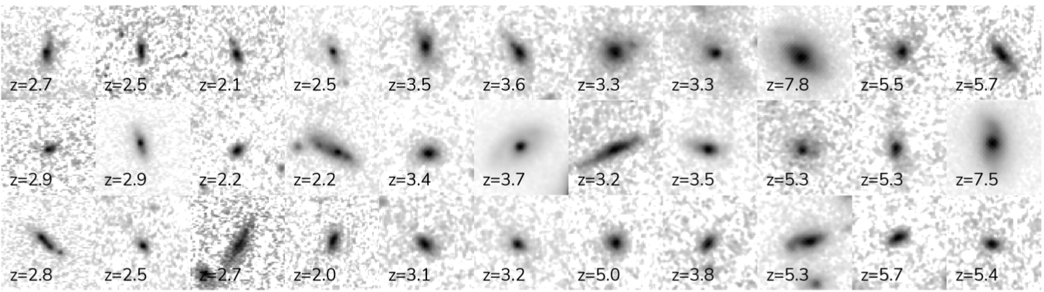
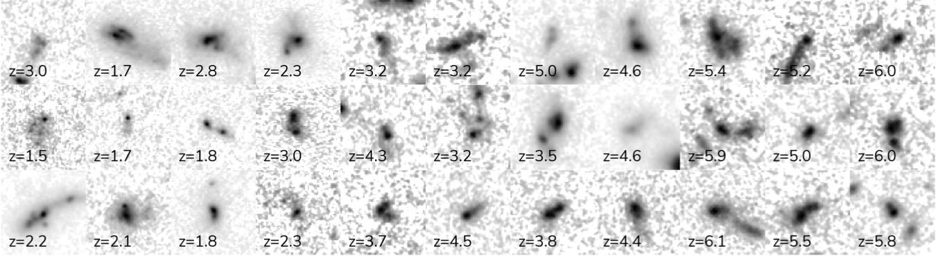
Spheroids
Disks
Irregulars

Slide 10
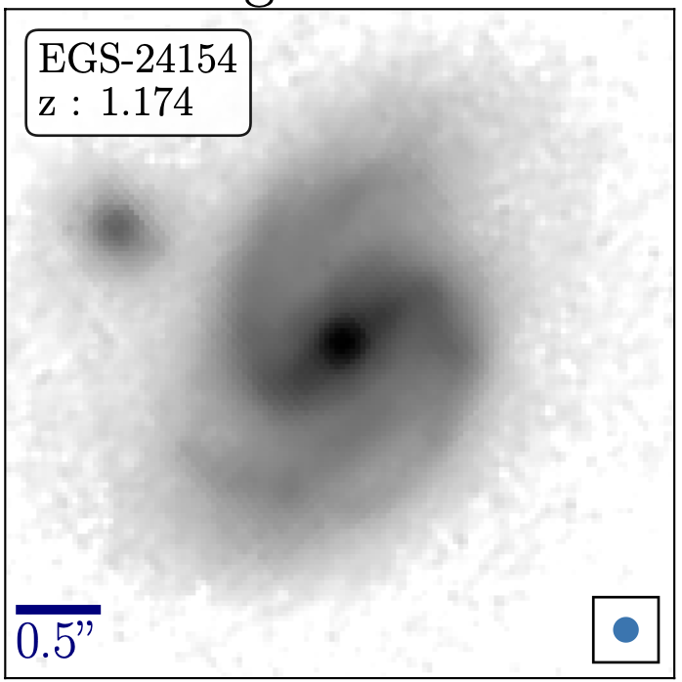
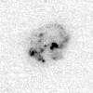
Your Goal
Next column, the features: spiral, bar, ring, clumpy
Spiral: can you identify arms?
Bar: does the galaxy have a bar through the center?
Ring: is there a ring around the galaxy?
Clumpy: are there clumps in the galaxy?
Image from Guo, Y., et. al. (2022)

Slide 11
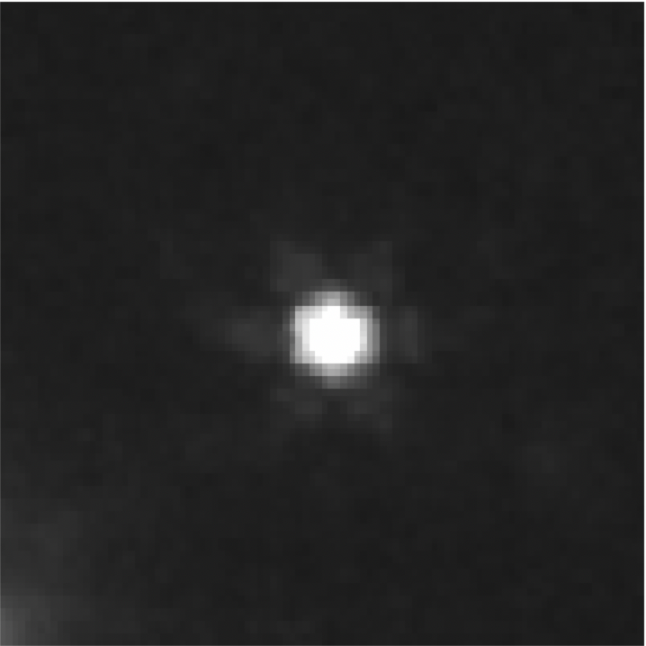
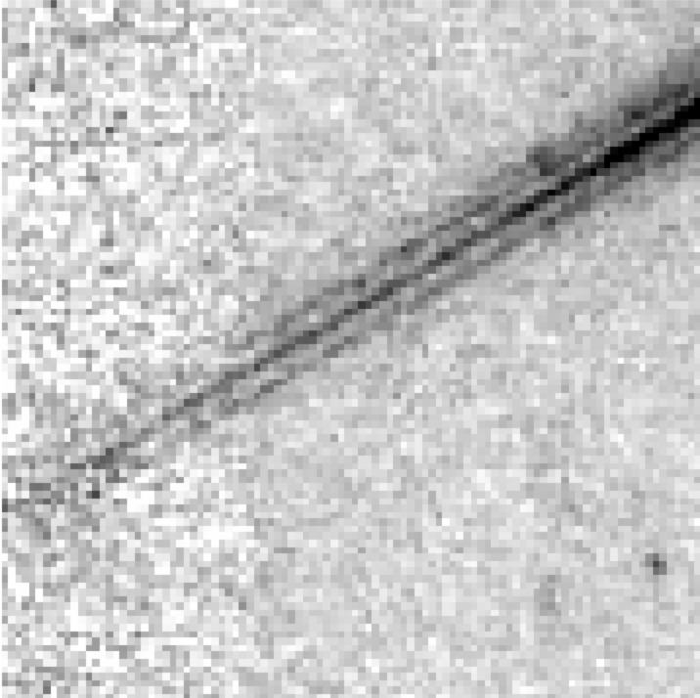
Your Goal
Next column, other features: compact/starlike, undefined
Compact/starlike: are there wings or spike patterns with no extended component
Undefined: too faint or noisy, no object shows up, cosmic rays going through the objects
Last column is for comments
if you want to discuss more about the object then do so here

